Slide 1
Python

Slide 2

What is Python?
Python is a popular high-level programming language used in various applications.
Python is an easy language to learn because of its simple syntax
Python can be used for simple tasks such as plotting or for more complex tasks like machine learning

Slide 3
Why You Choose it field?
Python is easy to understand and once you do, you can use those skills to land a wonderful career in the rapidly developing data science industry.

Slide 4
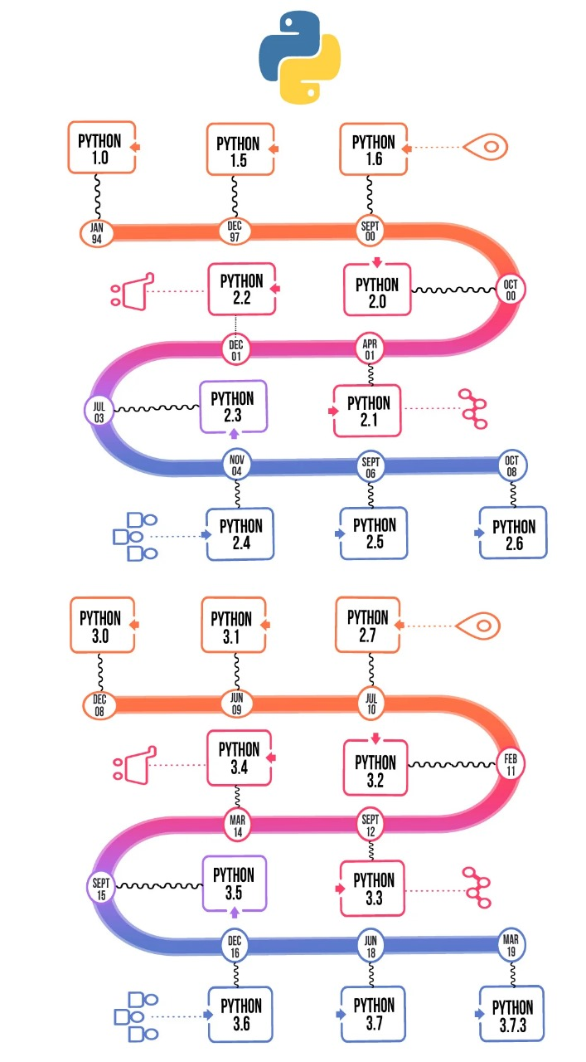
The Technological Upgradation

Slide 5
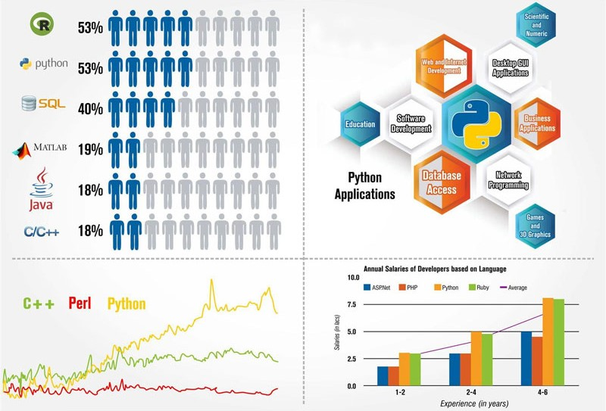
Areas of growth

Slide 6
PYTHON ADVANTAGES - PLUS POINTS
Easy to Use.
Expressive Language.
Interpreted Language.
Its Completeness.
Cross Plat Form Language.
Free and Open Source.
Variety of Usage/Applications.

Slide 7
PYTHON DISADVANTAGES - MINUS POINTS
Speed.
Mobile Development.
Easy-to-maintain.
Memory Consumption.
Database Access.
Runtime Errors.
Not Strong on Type-Binding or Dynamic Typing.

Slide 8
PYTHON IDE / IDLE
IDLE (short for integrated development environment or integrated development and learning environment) is an integrated development environment for Python, which has been bundled with the default implementation of the language since 1.5.2b1. ... Pythonshell with syntax highlighting.

Slide 9
Thank you

